Slide 1
Data Science Salary Analysis
W E L C O M E
By: Sue Susman, MEd, BSN, RN

Slide 2

Hello! I’m...
Sue Susman
I’m a graduate student at Merrimack College in the MS Data Science Program.

Slide 3


01
02
03
Background
Data Overview
Data Cleaning
04
05
Data Visualization
Conclusion

Slide 4



My project is focused on attempting to understand various factors of data science positions that can affect salary (USD).
1.Is it possible to predict the a data scientist’s salary based on their company’s size, location, working remotely vs. in the office, job title, and experience level?

Slide 5

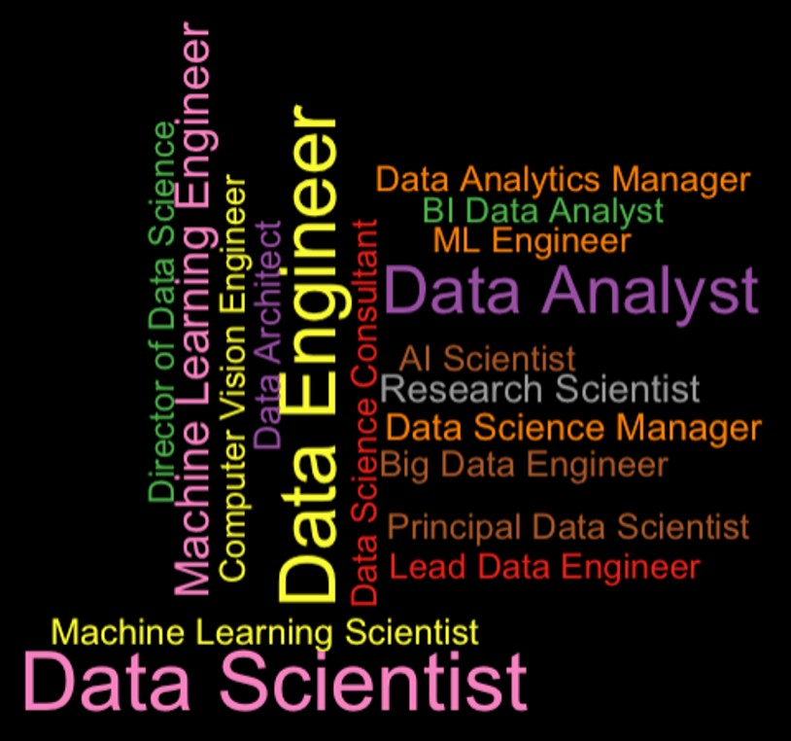


Slide 6
Column | Description
work_year | The year the salary was paid.
experience_level | The experience level in the job during the year with the following possible values: EN (Entry / Junior), MI (Mid / Intermediate), SE (Senior / Expert), EX (Executive / Director)
employment_type | The type of employment for the role: PT (Part-time), FT (Full-time), CT (Contract), FL (Freelance)
job_title | The role worked in during the year.
salary | The total gross salary amount paid.
salary_currency | The currency of the salary paid as an ISO 4217 currency code.
salary_in_usd | The salary in USD (FX rate divided by avg. USD rate for the respective year via fxdata.foorilla.com).
employee_residence | Employee's primary country of residence in during the work year as an ISO 3166 country code.
remote_ratio | The overall amount of work done remotely; possible values are as follows: 0% (No remote work (less than 20%)), 50% (Partially remote), 100% (Fully remote (more than 80%))
company_location | The country of the employer's main office or contracting branch as an ISO 3166 country code.
company_size | The average number of people that worked for the company during the year: S (less than 50 employees (small)), M (50 to 250 employees (medium)), L (more than 250 employees (large)) ₆

Slide 7

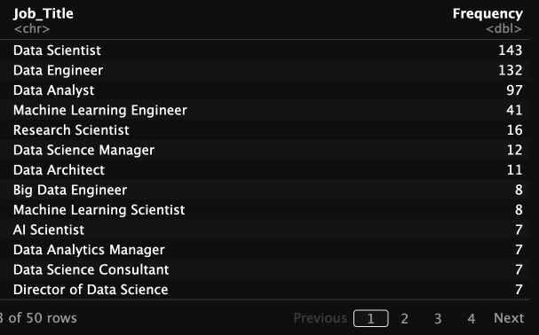
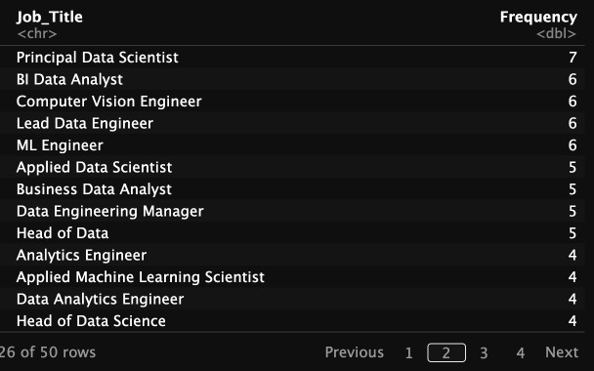
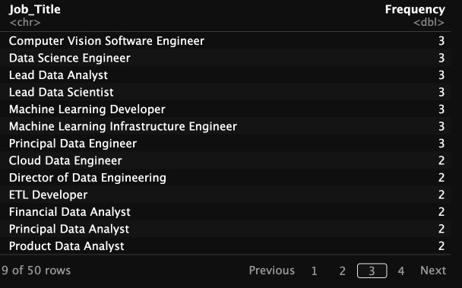
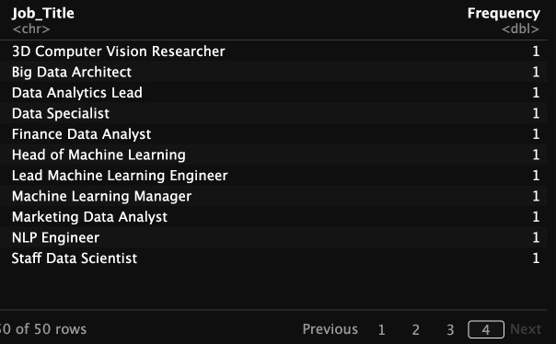

Slide 8
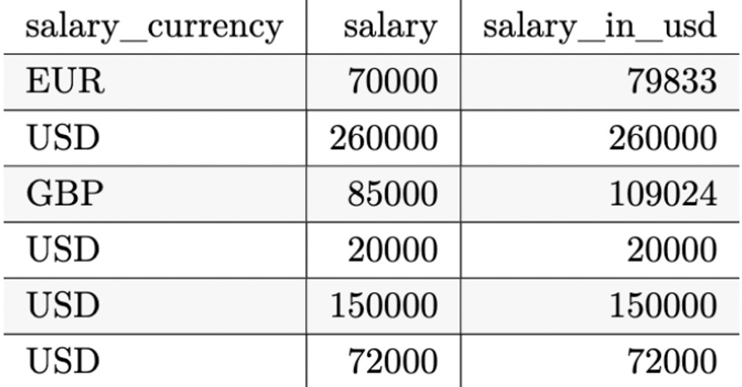


Slide 9
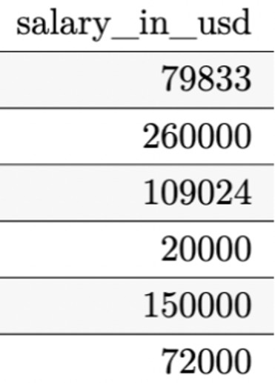




Slide 10
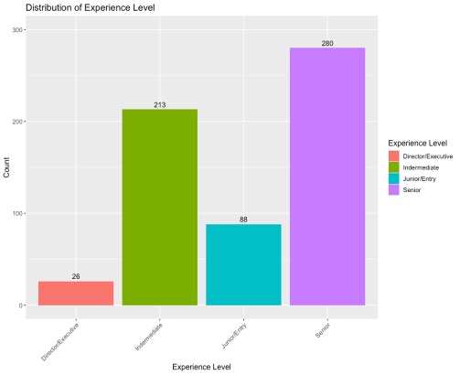
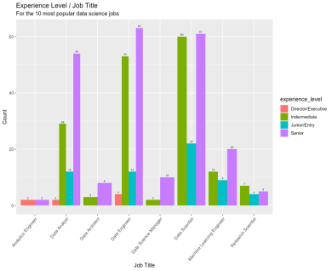
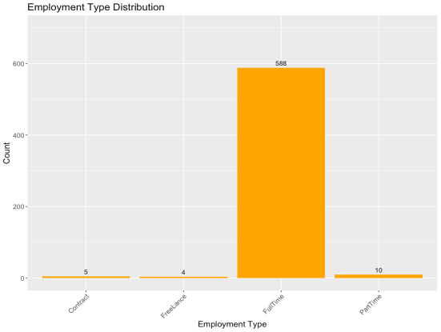

Slide 11
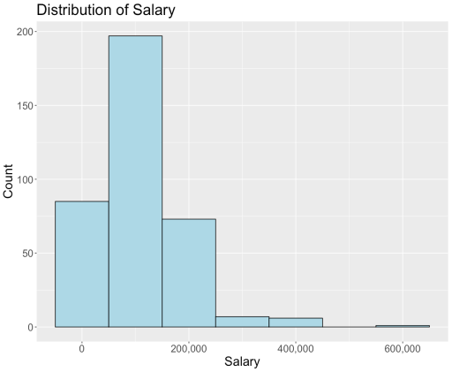
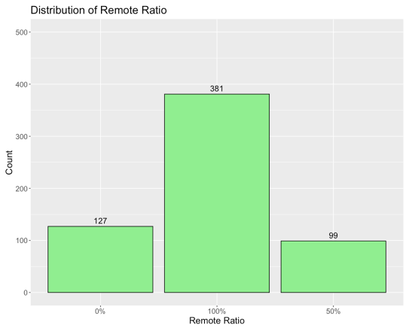
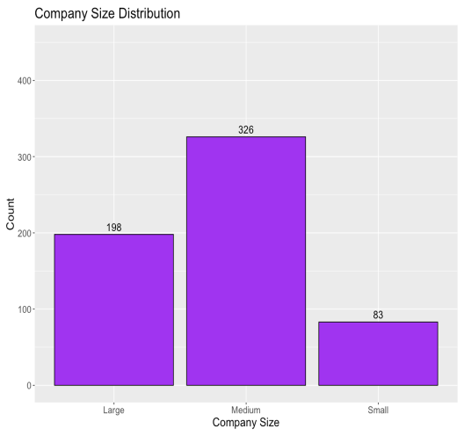

Slide 12

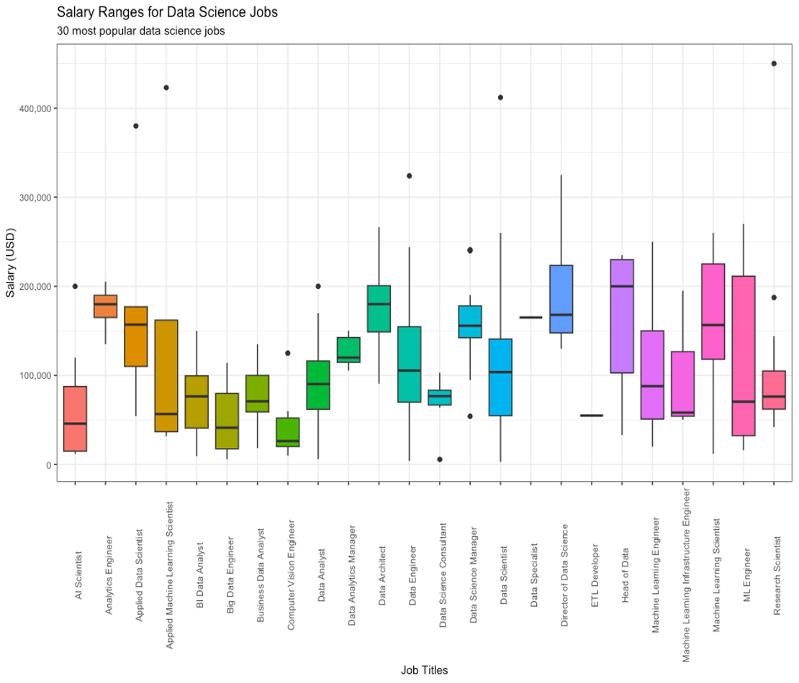

Slide 13
In conclusion, this analysis provides a valuable snapshot of the current state and trends of data science salaries in the US, which can help data scientists and employers make informed decisions and plan their careers.

Slide 14





Free themes and templates for
Google Slides or PowerPoint
NOT to be sold as is or modified!
Read FAQ on slidesmania.com
Do not remove the slidesmania.com text on the sides.
Sharing is caring!

